Slide 1

DEEP LEARNING PROJECT
Handwritten Digit
Recognition System
Using Convolutional Neural Networks (CNN)
Made By: Hosam Abdullah Alturaysi
Supervised By: Eng. Bader Albarraq
99.25%
10
50
Test Accuracy
Digit Classes
Max Epochs
Python • TensorFlow / Keras • CNN Architecture

Slide 2
01 | THE PROBLEM
Teaching Machines to
Read Human Handwriting
The Challenge
Human handwriting is inherently messy — digits look different from person to person, pen to pen, angle to angle.
The Dataset
MNIST benchmark: 70,000 grayscale 28×28 images of handwritten digits (0–9), split into 60K training and 10K test samples.
Why It Matters
Digit recognition powers postal automation, bank cheque processing, form digitisation, and touchscreen interfaces worldwide.

Slide 3
02 | OUR APPROACH
A Robust CNN Pipeline
Smart Preprocessing
Data Augmentation
1
Images reshaped to 28×28×1 and pixel values normalised to [0,1] for faster convergence.
2
Random rotations, zooms, and translations applied on-the-fly to simulate real-world handwriting variation.
CNN Architecture
Smart Callbacks
3
Stacked Conv2D → MaxPool → Dropout layers learn spatial features, followed by Dense classification head.
4
EarlyStopping · ReduceLROnPlateau · ModelCheckpoint — training halts at optimal weights automatically.

Slide 4
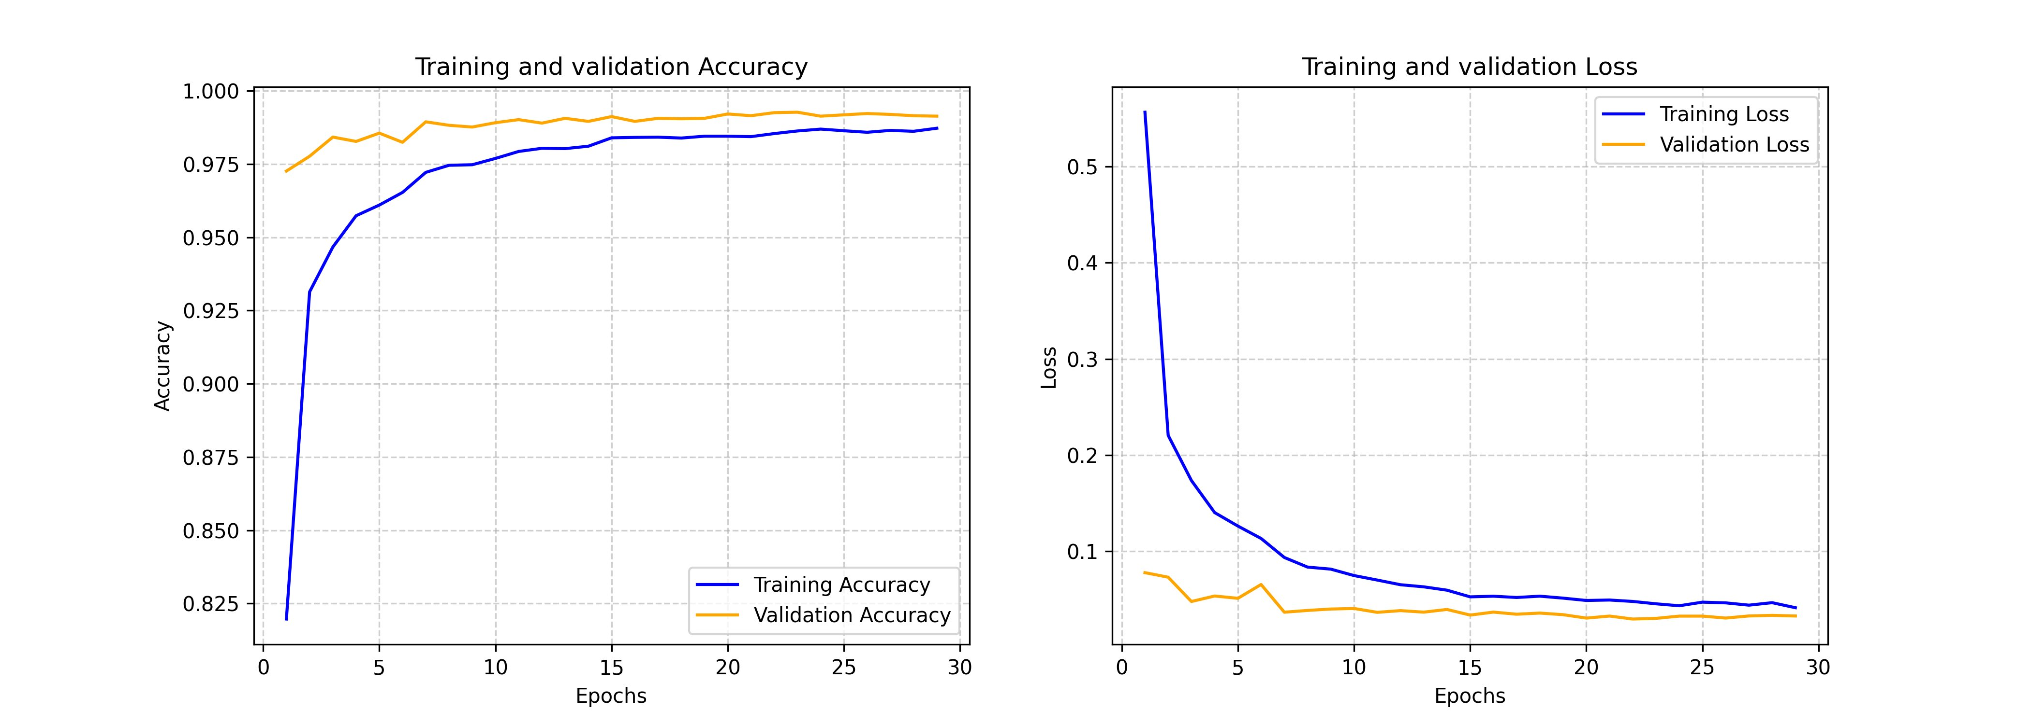
03 | RESULTS
Exceptional Performance Metrics
99.25%
99.26%
0.0297
98.54%
Test Accuracy
Val Accuracy
Val Loss
Train Accuracy
on unseen data
epoch 22/50
epoch 22/50
no overfitting
Training & Validation Curves

Slide 5
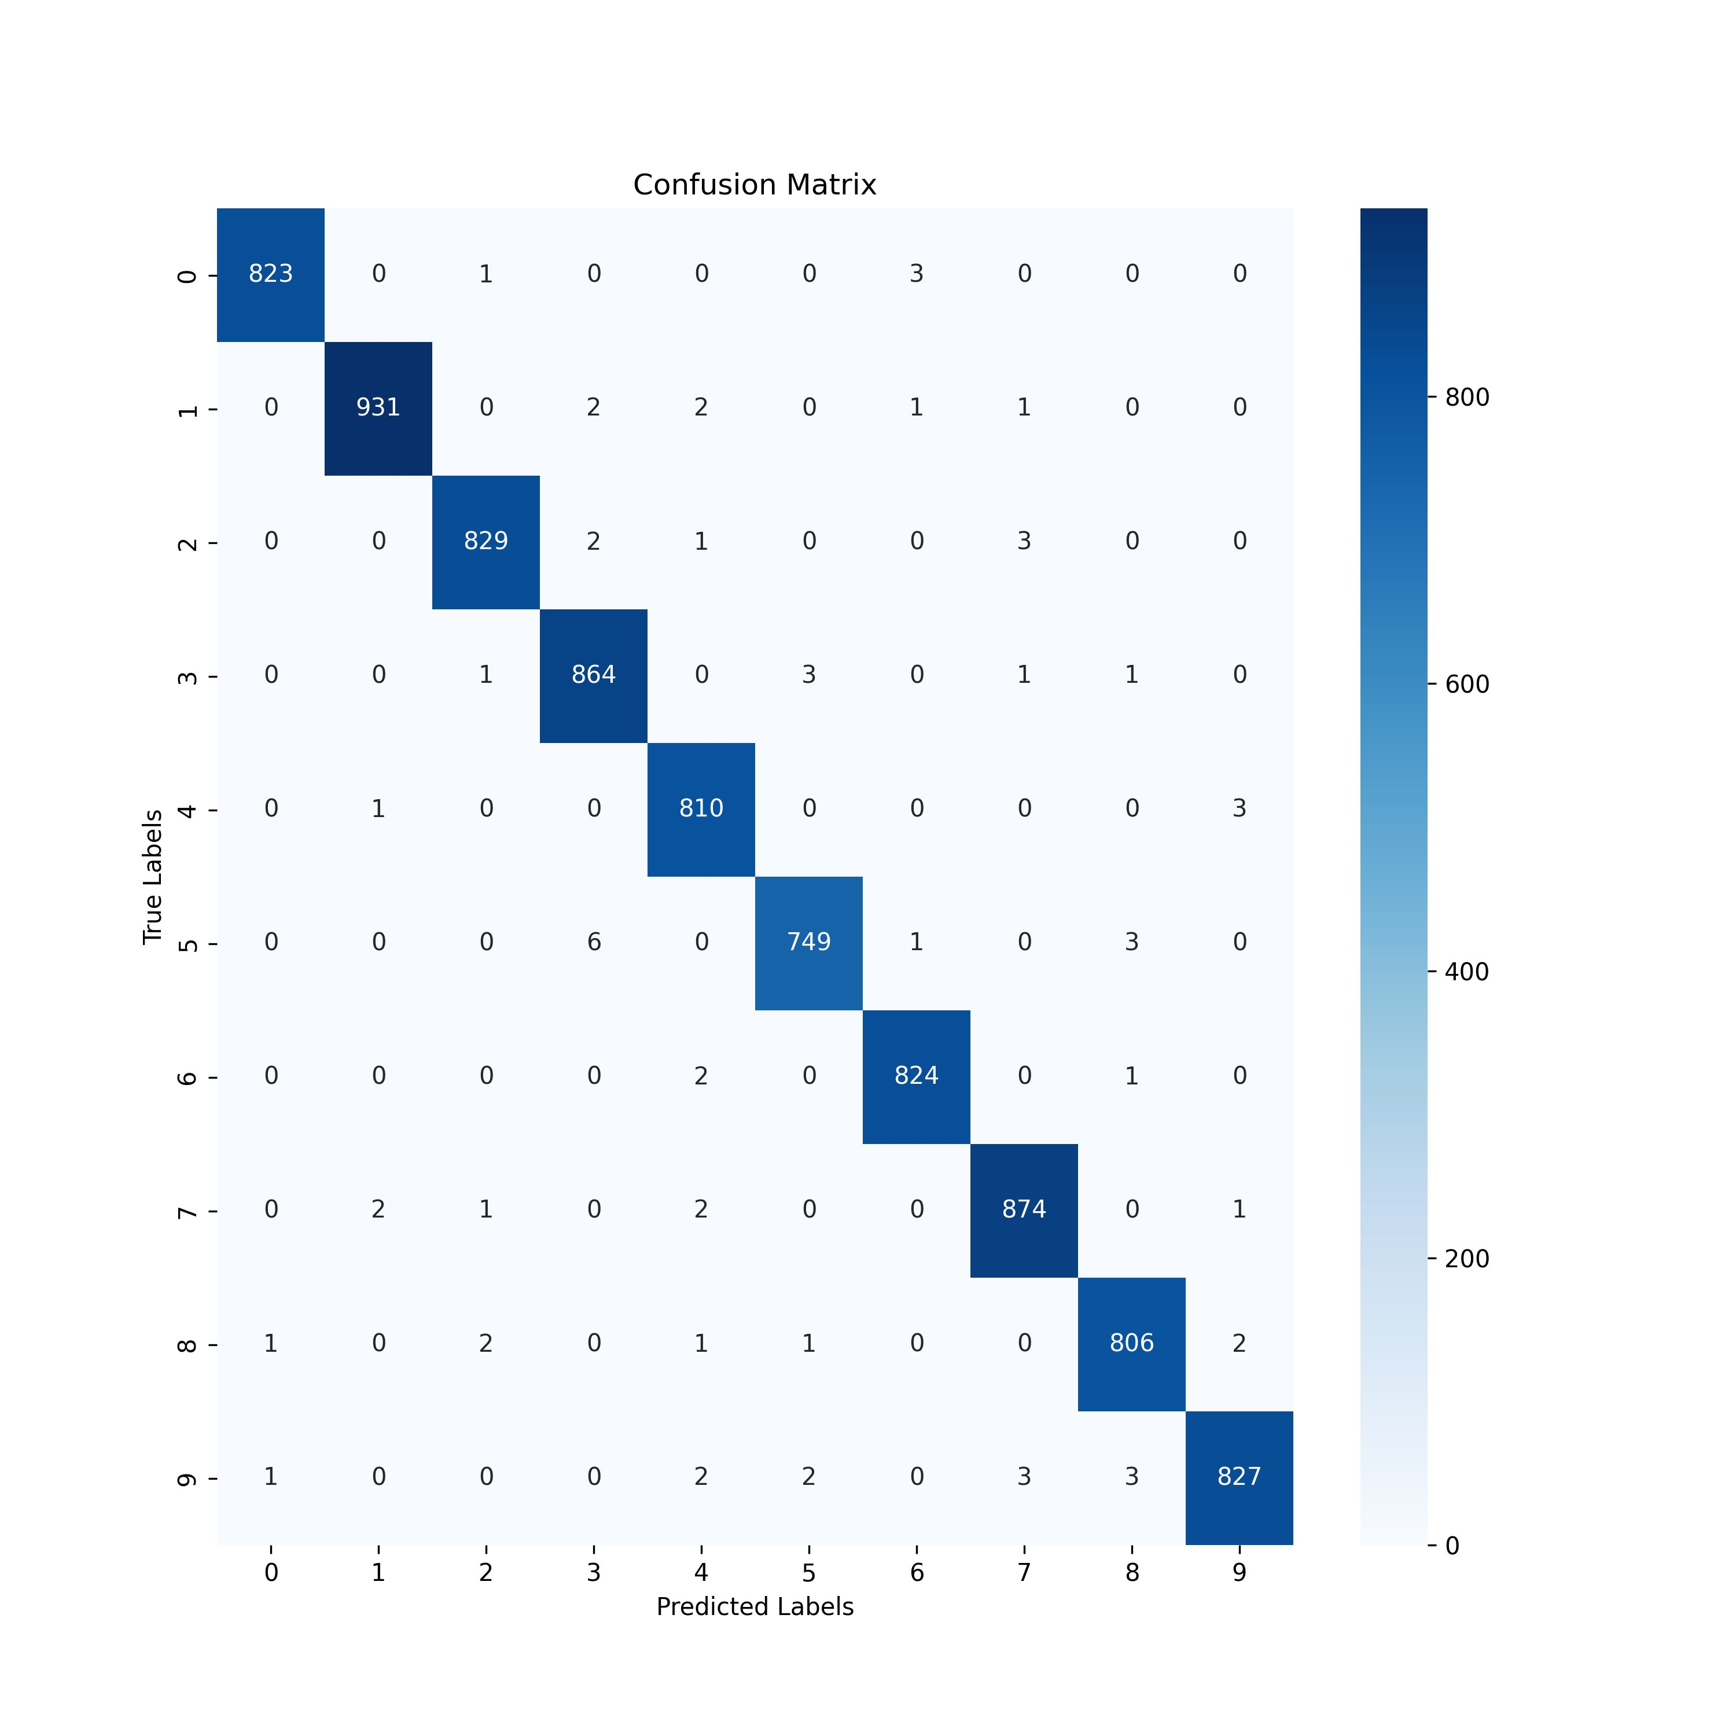
04 | ANALYSIS
Confusion Matrix — Where the Model Struggles
Digit '1' best classified: 931 correct, only 7 errors total
Digit '5' vs '3' most confused: 6 samples of '5' predicted as '3'
Diagonal dominance confirms near-perfect per-class precision
Digit '5' has the most off-diagonal errors (10 total)
No class systematically confused with another — errors are sparse

Slide 6
05a | HONEST LIMITATIONS
What the Model Cannot
Reliably Do (Yet)
Clean, Centred Digits Only
Single Digit at a Time
MNIST images are small, greyscale, and centred. Real-world photos of handwritten digits (in natural light, on lined paper, in a word) will likely drop accuracy significantly.
The model classifies isolated digits. Recognising a full number or equation requires a separate segmentation step not included here.
No Orientation Robustness
Limited Language Generalisation
Augmentation used ±10° rotations. Upside-down or steeply angled digits (e.g. handwriting slanted 45°) may still be misclassified.
Trained solely on Western Arabic numerals. Non-Western numeral systems (Hindi, Arabic-Indic, etc.) are outside the model's scope.

Slide 7
05b | NEXT STEPS
Where Do We Go From Here?
Deploy as a Web App
Wrap the model in a Flask / FastAPI backend with a canvas-based frontend so users can draw digits and see live predictions.
Extend to Full Numbers
Add a segmentation pipeline (EAST or projection profiles) to detect and split multi-digit strings before feeding each digit to the CNN.
Train on Richer Data
Incorporate EMNIST, SVHN (Street View House Numbers), and crowd-sourced messy samples to improve real-world robustness.
Experiment with Architectures
Test ResNet, EfficientNet, or Vision Transformers (ViT) to push accuracy further and benchmark against the current CNN baseline.
Model Compression
Apply quantisation and pruning to produce a lightweight TFLite / ONNX model suitable for on-device mobile inference.

Slide 8
SUMMARY
A 99.25% Accurate CNN
for Handwritten Digit Recognition
✓
Built and trained a CNN with data augmentation and smart callbacks
✓
Achieved 99.25% test accuracy — competitive with published benchmarks
✓
Validated with confusion matrix showing sparse, interpretable errors
✓
Identified clear limitations and a concrete roadmap for improvement
Thank You

